Slide 1
PowerApps with Microsoft Azure
Karan Kathuria

Slide 2
PowerApps Canvas apps with Microsoft Azure
Karan Kathuria

Slide 3

Karan Kathuria
Technology enthusiast
Solution Architect at Nagarro, Gurgaon
Interested in cloud, big data, low-code platforms

Slide 4
Session objectives
Understand PowerApps Canvas apps
Connectors available for Microsoft Azure
Hands-on demo using few Azure PaaS connectors
Q&A

Slide 5
Canvas apps

Slide 6
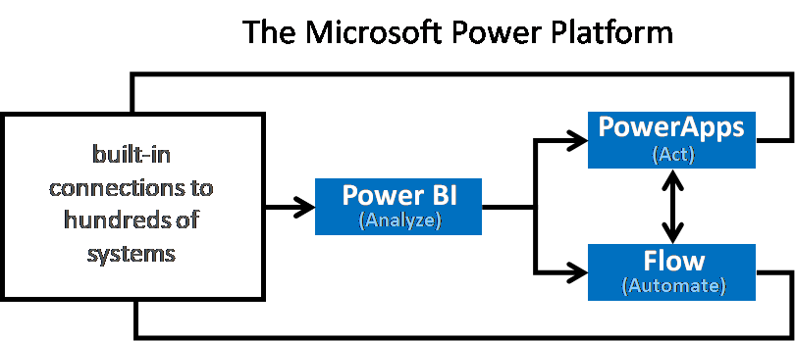
Power Platform
Image source: https://cloudblogs.microsoft.com/dynamics365/bdm/2019/01/29/the-microsoft-power-platform-empowering-millions-of-people-to-achieve-more/

Slide 7
Azure connectors
Azure AD
Azure Application Insights
Azure Automation
Azure Blob Storage
Azure Container Instance
Azure Cosmos DB
Azure Data Factory
Azure Data Lake
Azure DevOps
Azure Event Grid
Azure Event Grid Publish
Azure File Storage
Azure IoT Central
Azure Key Vault
Azure Kusto
Azure Log Analytics
Azure Log Analytics Data Collector
Azure Monitor Logs
Azure Queues
Azure Resource Manager
Azure Sentinel
Azure SQL Data Warehouse
Azure Table Storage
SQL Server

Slide 8
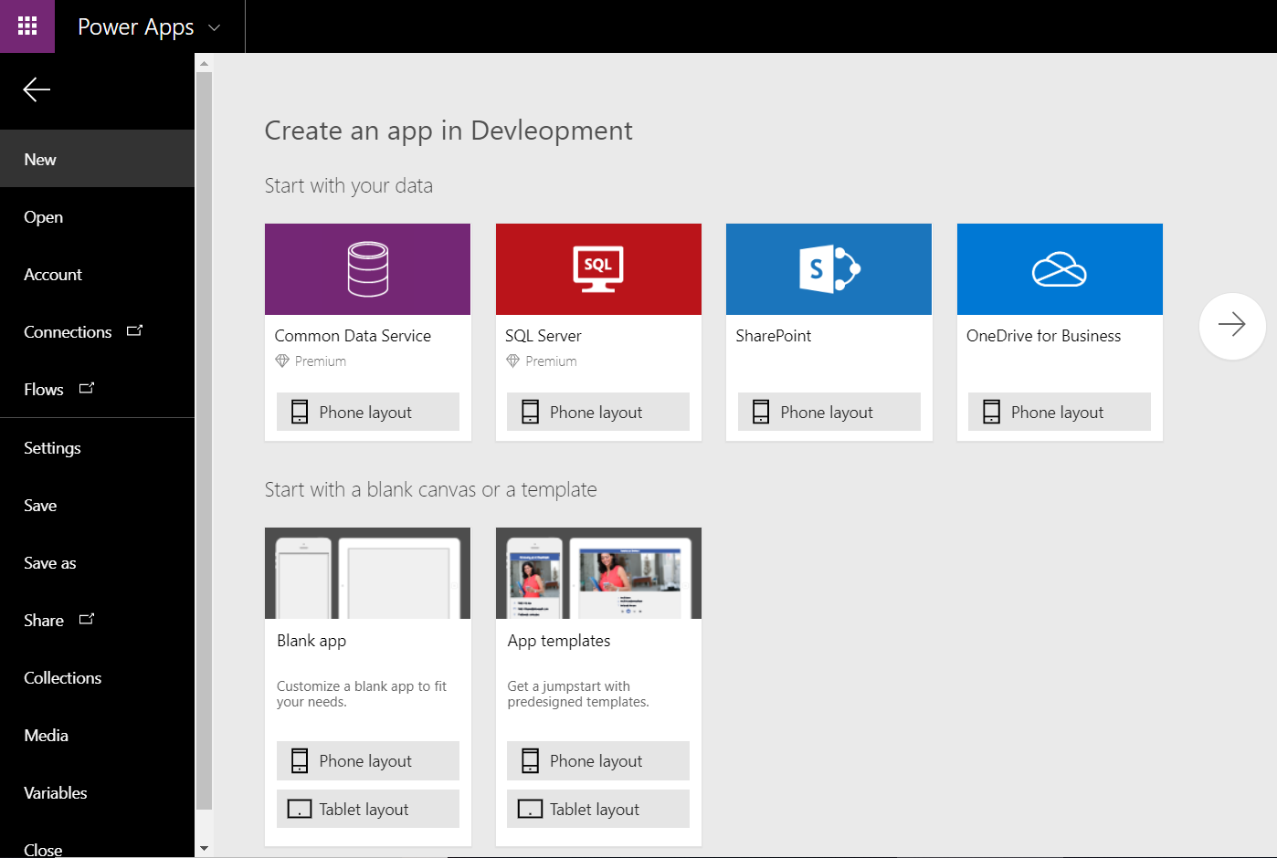
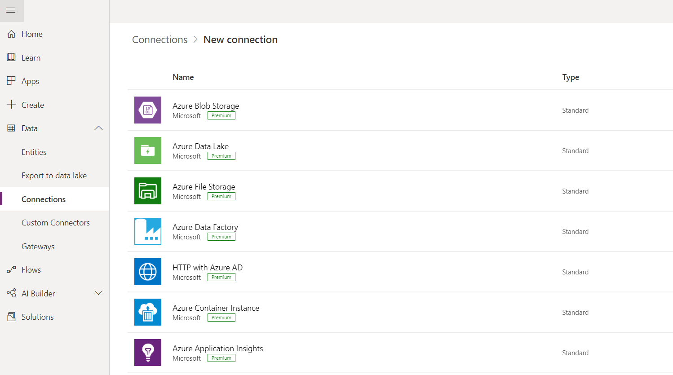
Create a connection

Slide 9
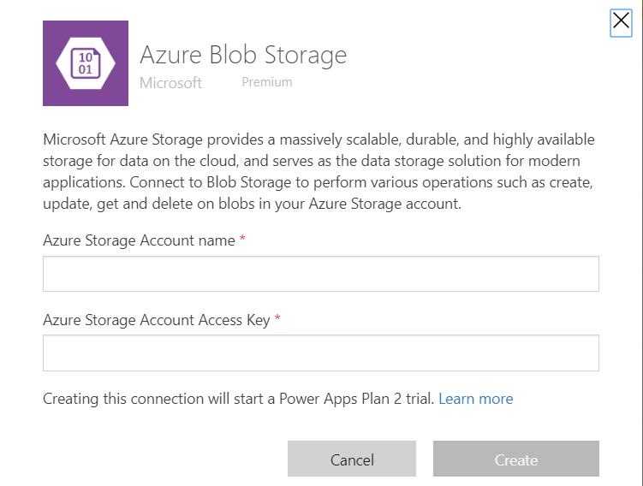
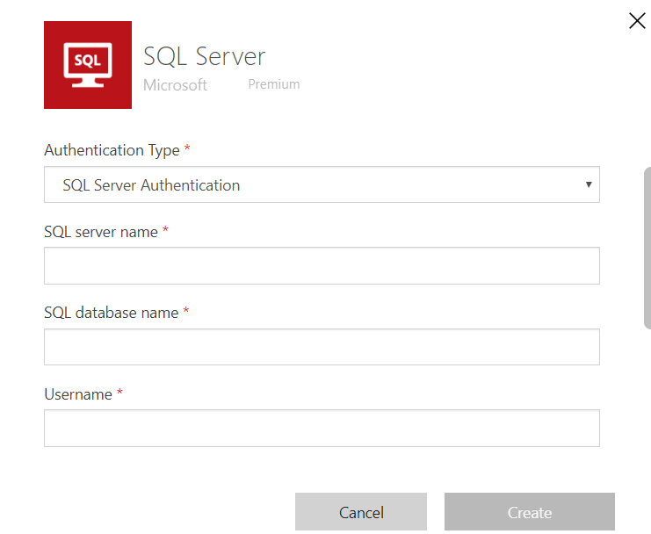
Create a connection

Slide 10
Azure SQL Database connector
Limitations
The app name can include only letters, numbers, hyphens, parentheses, or underscores.
Power Apps requires SQL authentication to connect to SQL Database.
You can select only one table while you are creating a canvas app from the Azure portal. Customize the app after the app is created if you want to add more tables and other data sources by adding more data connections.
Power Apps cannot connect to SQL Database using VNet Service Endpoints. For more information, read allowing access through VNet Service Endpoints.

Slide 11
Azure Blob Storage connector
Copy blob | This operation copies a blob. If blob is being deleted/renamed on server right after it was copied, connector may return HTTP 404 error by it's design. Please use a delay for 1 minute before deleting or renaming newly created blob.
Create blob | This operation uploads a blob to Azure Blob Storage.
Create block blob | This operation uploads a block blob to Azure Blob Storage.
Create SAS URI by path | This operation creates a SAS link for a blob using the path.
Delete blob | This operation deletes a blob.
Extract archive to folder | This operation extracts an archive blob into a folder (example: .zip).
Get available access policies | This operation gets available shared access policies for a blob.
Get blob content | This operation retrieves blob contents using id.
Get blob content using path | This operation retrieves blob contents using path
Get Blob Metadata | This operation retrieves blob metadata using blob id.
Get Blob Metadata using path | This operation retrieves blob metadata using path.
List blobs | This operation lists blobs in a container.
List blobs in root folder | This operation lists blobs in the Azure Blob Storage root folder.
Set blob tier by path | This operation sets a tier for a block blob on a standard storage account using the path.
Update blob | This operation updates a blob in Azure Blob Storage.

Slide 12
Demo: Canvas app with Azure SQL & Blob storage connectors

Slide 13
Any Questions?

Slide 14

Please fill out the survey! & Win Swags!!
https://www.powerplatformbootcamp.com/survey

Slide 15
Thank You For Attending

